Slide 1
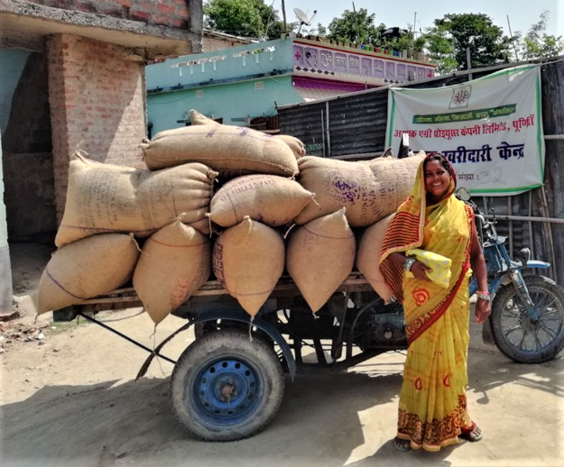
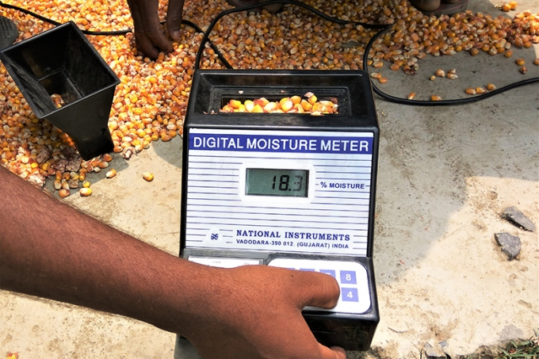
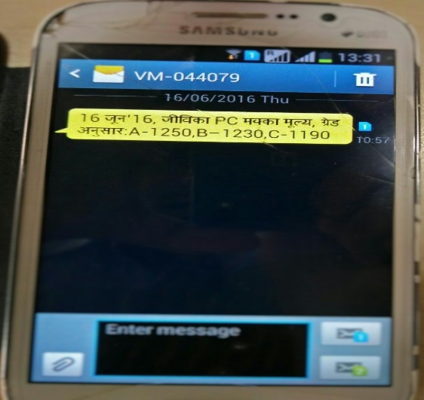
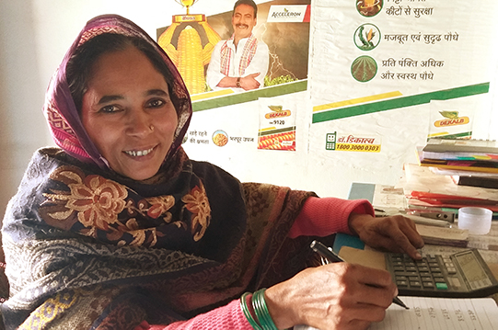
Making Digital technology work for women farmers
Parmesh Shah, Global Lead, Rural Livelihoods and Agriculture Employment,
Agriculture Global Practice
The World Bank
Email: pshah@worldbank.org
Twitter: @ShahParmesh

Slide 2


Before the Project
Lack of access to credit from formal banks
Lack of knowledge on agriculture technology
Lack of institutional platforms for the Poor
Notes:
Kuraisa’s journey was transformative in the sense that she started in a very difficult circumstance.
Before the project, the poor women did not have access to formal credit, not having good knowledge on agriculture technology, had no place to express their voice because of lack of institutional platform.
What did we do to overcome the situation and empowered women economically and socially. I will take you through our journey of transformational change

Slide 3
Laying the foundation for Innovation
Jeevika mobilized 12.5 million poor rural women into Self Help Groups (SHGs) and their federations
Creating 9 million clients for formal banks in Bihar
Leveraging $800 million from formal banks for poor rural women
Notes:
First the project laid the foundation for enterprise development.
The project mobilized poor rural women into SHGs and mobilized them for saving and internal group lending

Slide 4
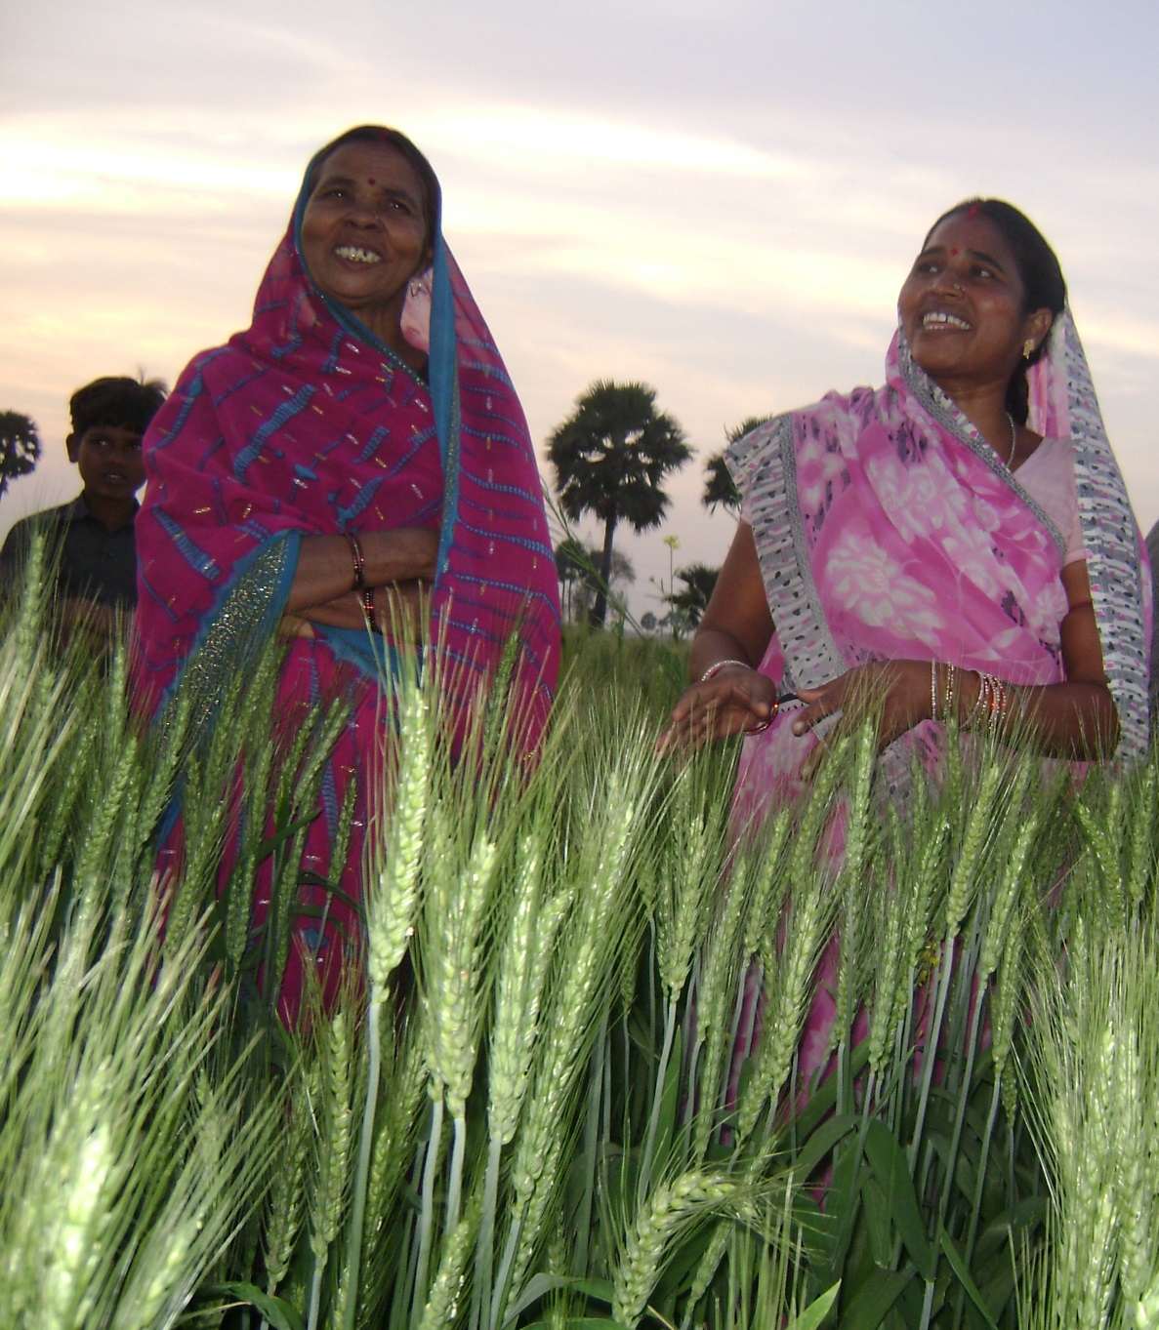
Jeevika Enhanced productivity through technology and skill development
Nearly 500,000 women farmers increased agriculture/livestock productivity
Notes:
The project also supported women farmers through technology and skill development in agriculture and livestock to enhance their productivity and income.

Slide 5
The innovation – Leveraging Digital Technology for Connecting women farmers to markets president’s award for innovation- 2018

Slide 6





A SMALL FARMERS PLIGHT
Institutional Buyer
Large Trader
Local Trader
Woman Small-farmer

Slide 7
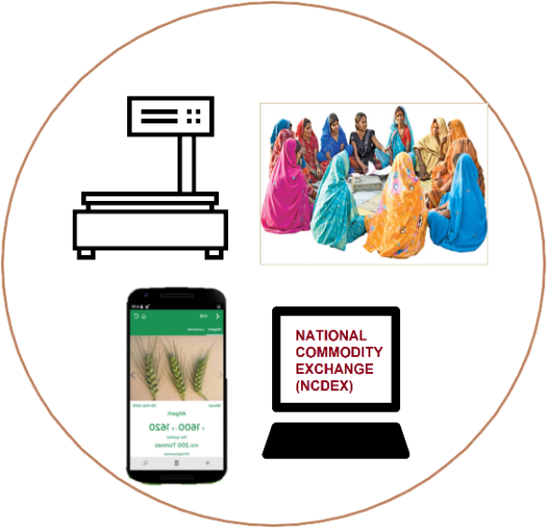

THE INTERVENTION
Institutional Buyer
Farmer Producer Company
Daily Price Information via mobile
Digital scales
Digital moisture meters
Higher prices with future trading
Profit sharing with members
Woman Small-farmer

Slide 8
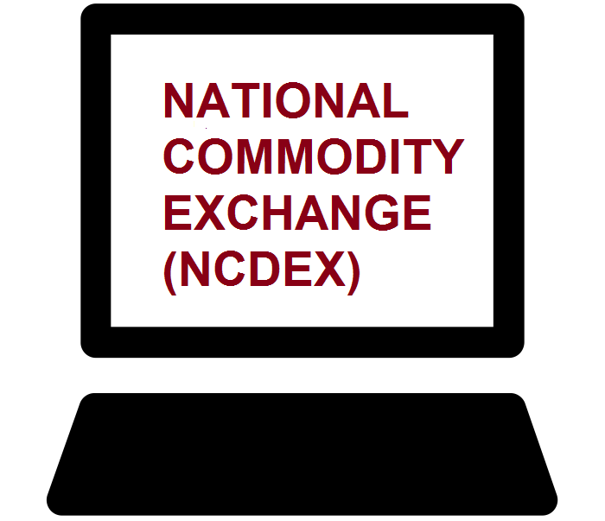
THE NEW NORMAL
Higher Prices through aggregation & direct sale to bigger markets
Institutional Buyer
Warehouse receipts and off-season sale with profit sharing

Slide 9
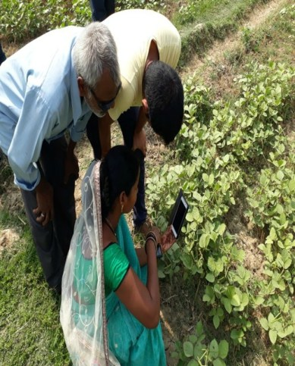
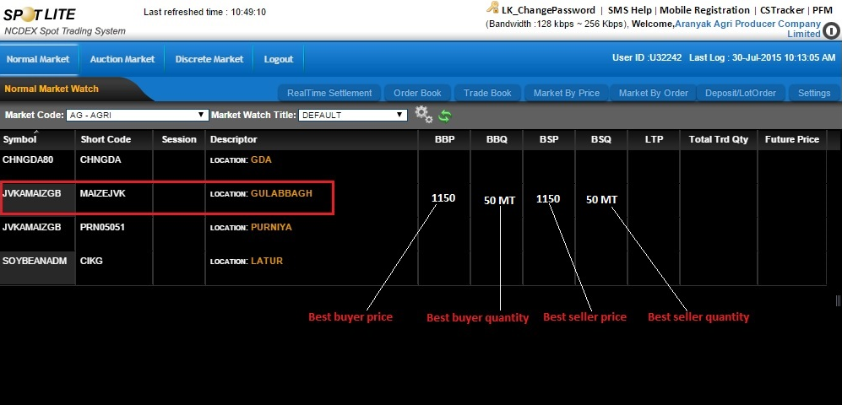
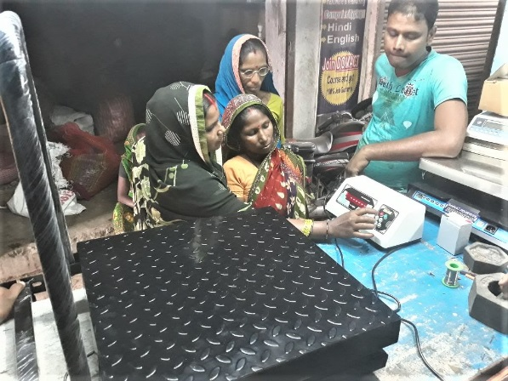
inclusive business model that uses tech-platforms
Electronic platform for commodity trading
mobile based crop/price advisory
Networked warehouses
Digital weighing machine
Moisture meters

Slide 10

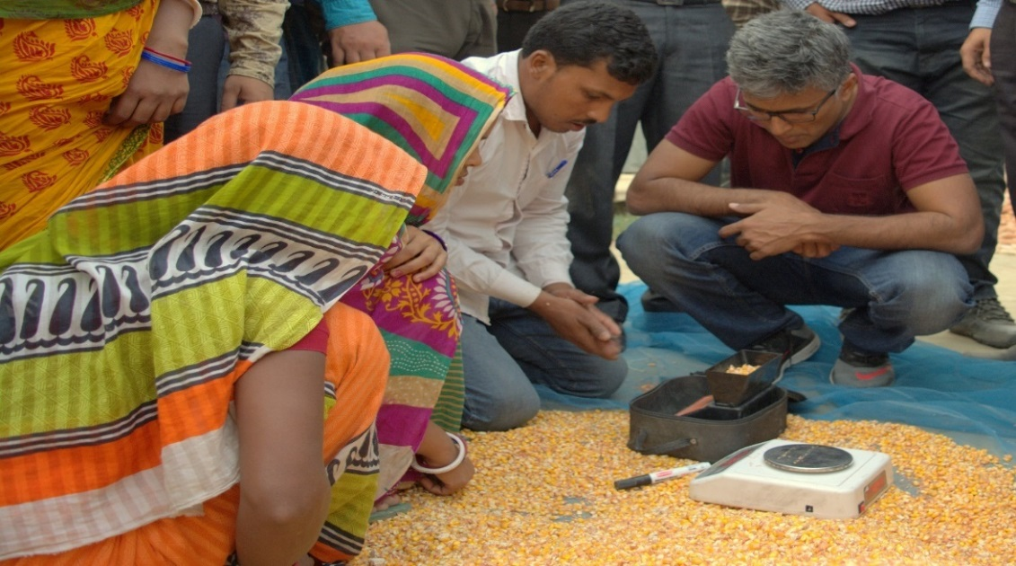
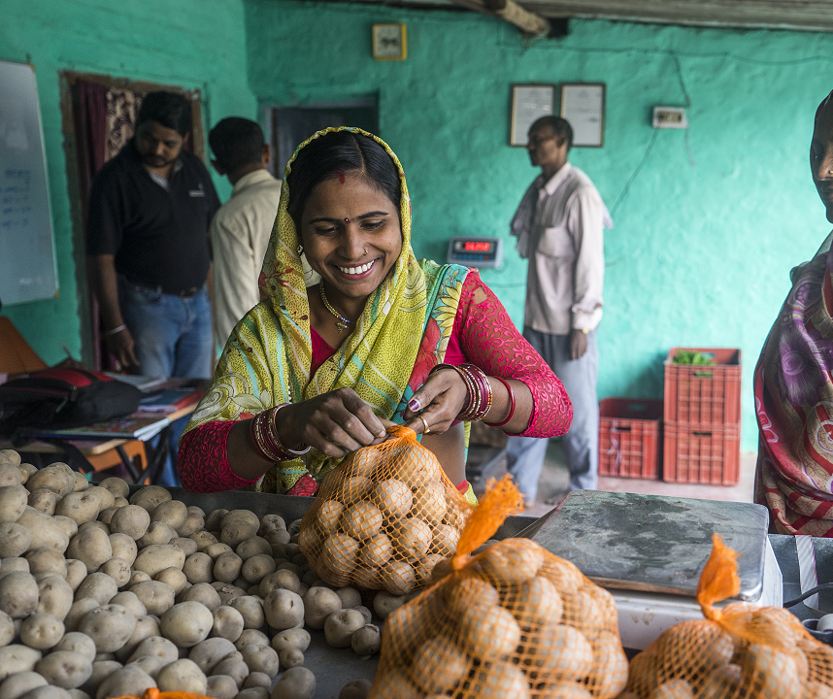
Commodities being marketed by technology platform
Aaranyak Farmer Producer Company Ltd – Purnea
  10,000 farmers; $2 million turnover
  First women owned Farmer Producer Company in Bihar registered on National Commodity Exchange
Samarpan JEEViKA Farmer Producer Company Ltd
  2,500 farmers; $ 800,000 turnover
  First women owned Farmer Producer Company in Bihar linked with modern retail stores like Big Bazaar and Reliance Fresh

Slide 11
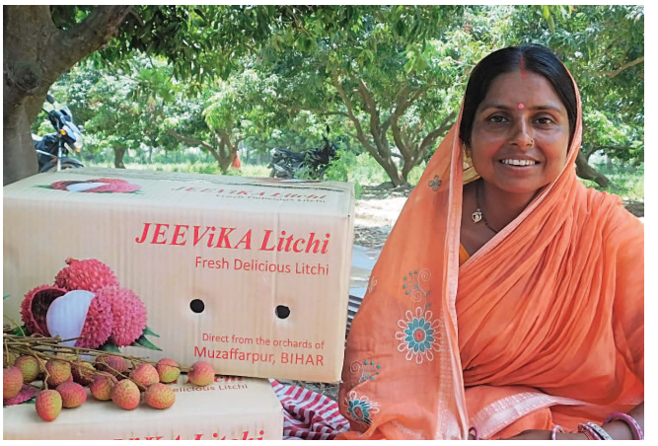
Samarpan JEEViKA Mahila Kisan Producer Company Ltd., Muzaffarpur
  The company is in a unique position to leverage on popularity of Shahi Litchi of Bihar and is gearing up for marketing of 100 MT

Slide 12
Key impacts
Financial turnover has risen 10 fold (US$ 2Million)
Price realization up 15-20%
Farmers Producer Companies (FPC) membership 10,000 within Bihar, and to 50,000 across India.
An inclusive business model that uses tech-platforms to empower and connect women farmers with formal agri-markets.
.

Slide 13

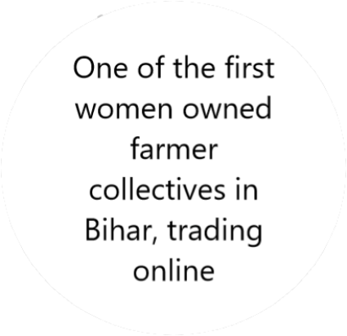
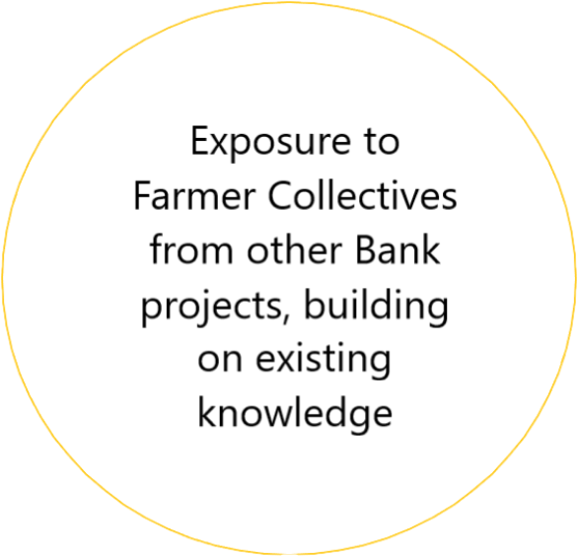
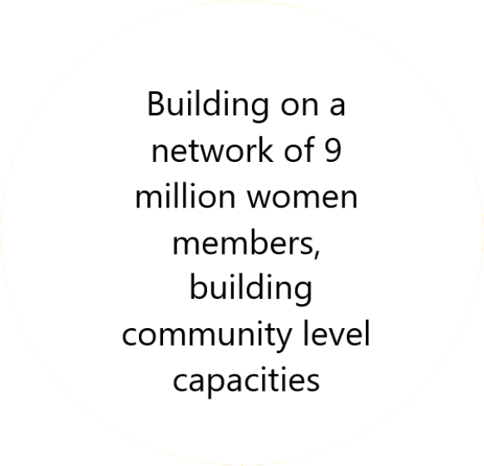
What the Bank did
4 Cs
Convince
Convene
Capacity
Crowd-In

Slide 14
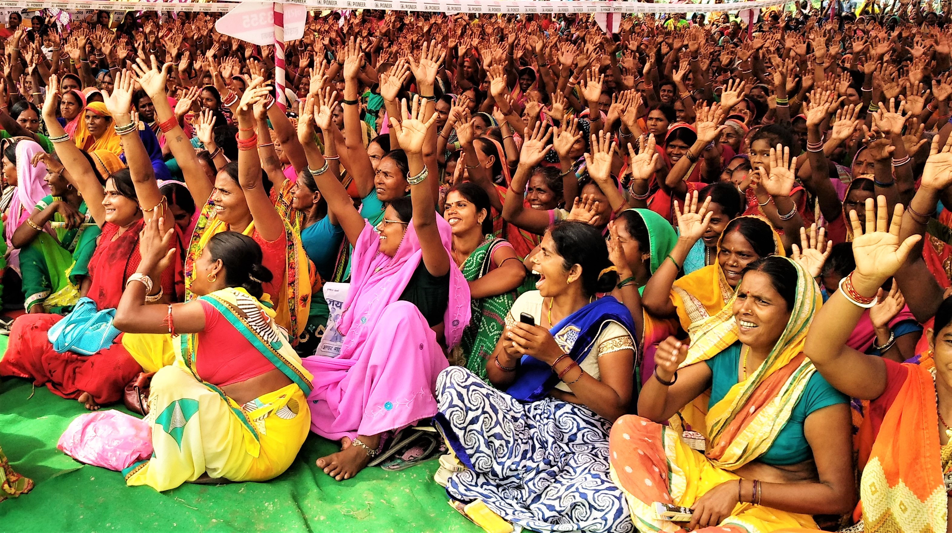
Making Markets work for the Poor

